Slide 1
I/O Management
Chapter 11
Last Updated 4/9/2018 2:20 PM

Slide 2
Operating Systems I/O Design Objectives
Efficiency: Scheduling, strategies, and hardware designs to make I/O as efficient as possible.
To gain the best device utilization by scheduling I/O operations to maximize the number of operations performed over time.
To maximize system performance by minimizing processor blocking for I/O operations. Buffering, interrupts and DMA.
Generality: Standardizing the interfaces between OS layers.
Standard Application Programming Interfaces (API) used by applications to read from and write to any device.
Between the OS and device drivers provided by manufactures.
Hardware interfaces to physical devices e.g. SATA, USB, etc.
Notes:
We can connect a SATA drive from any disk manufacturer to any PC motherboard and the drive just works.

Slide 3
Layered Design Strategy
Operating Systems are designed in layers.
Upper-layers provide a standardized API/ABI utilized by programs to access I/O devices.
The method used to read / write from files and network sockets are very similar.
Lower-layers translate upper-layer ABI operations into device-specific operations.
Though the use of device drivers.
We can add new devices/hardware to a system and use them in the same manner i.e. with the same ABI operations.
Differences in drive technologies, capacities, manufactures, controllers are all hidden from the developer and user.
Notes:
What is on difference between how a file is accessed and a socket connection? Seeking

Slide 4
Layered I/O Architecture
Applications
User Space
Kernel Space
I/O System Calls (ABI)
File Systems
I/O Supervisor
(Disk Block Management)
Device Drivers
Device Controllers
Hardware
Physical Devices
Notes:
Discuss Linux Storage Stack Diagram.png here.

Slide 5
Generality in I/O Layers
The same I/O syscalls are used to access files across all device types.
read(), write(), seek(), open(), close(), ioctl(), others are used to access files on HDD, SSD, USB Drives, DVDs, etc.
The same I/O syscalls are used to access all filesystem types.
All filesystem types use the same block management services.
Device Drives standardize the interface between the operating system and device-specific features.

Slide 6
Device Drivers
Are software modules that are written to provide an interface between the OS and Hardware Devices and Controllers.
Drivers are software modules that…
Initializes the hardware devices and controllers on OS startup.
Provides interrupt handlers for device controllers.
Are used by the kernel to transfers data to and from the hardware device e.g. HDD.
Drivers are installed into the kernel.
Driver modules can be loaded or unload from the system (kernel) at runtime.

Slide 7
Data Transfer Types
Block-oriented Devices
Data is stored and transferred in fixed length blocks.
Storage devices (Disks) allow blocks of data to be targeted (saved and retrieved) at specific block numbers (addresses).
Stream-Oriented Devices
Transfers data as streams of bytes.
Data is read from an input, or written to an output device a byte at a time.
No direct addressing i.e. not possible to seek (skip past bytes).
Most non-storage devices (e.g. mouse or keyboard) are stream-oriented devices.

Slide 8
Drive Technologies
Disks maintain large amounts of persistent storage.
Hard Disk Drives use magnetic media to store data.
Seagate 8TB HDD for $260 ($33/TB).
Solid State Drives use flash memory to store data.
Samsung 16TB SSD for $7000 ($438/TB).
Physically HDD and SSD maintain persistent data in vastly different technologies and can transfer data at different rates.
SSD are roughly 10x faster than high-end HDD.
However, remember that system memory require only ns to retrieve data.
Notes:
Floating Gate Transistors persistent hold individual bits.

Slide 9
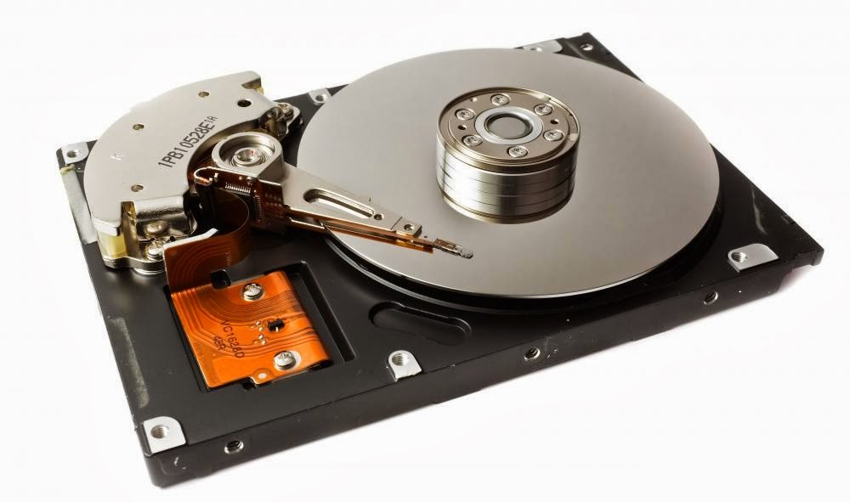
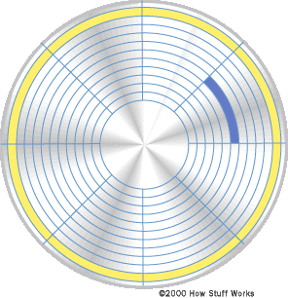
Hard Disk Drives
The physical design places constraints on how to efficiently data is written to or read from the magnetic media.
Platters / Heads / Tracks / Sectors / Cylinders
Interesting YouTube Video.
Notes:
https://www.youtube.com/watch?v=Cj8-WNjaGuM
https://www.youtube.com/watch?v=NtPc0jI21i0

Slide 10
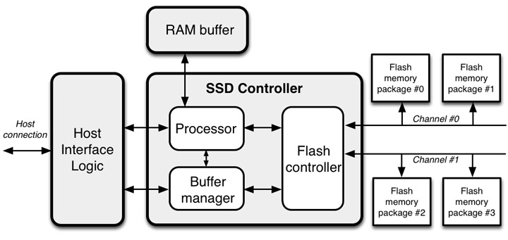
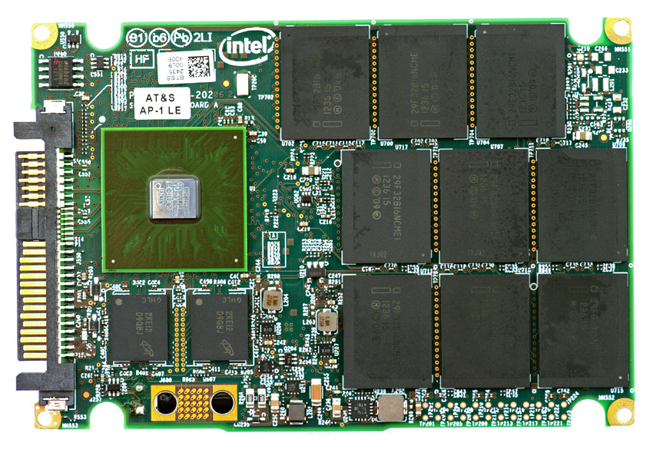
Solid State Drives

Slide 11
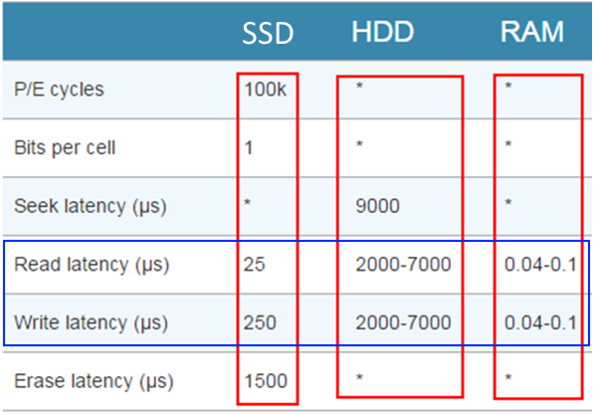
SSD Are Orders of Magnitude Faster than HDD
Notes:
SLC: Single Level Cell (1 bit / Flash Memory Cell)
MLC: Multi
TLC: Triple

Slide 12
Block Devices
Both SSD and HDD transfer data to / from the system in blocks of data.
Blocks of size 4K (2¹² or 4096) bytes.
The storage capacity of a drive is access as blocks of data.
1TB drive (2⁴⁰ bytes) has 268,435,456 4K-blocks.
Unlike memory, block data is not addressed as individual words.
To update a specific record’s content … 1) The block containing the record is read from the drive into memory. 2) The record / data within the in memory block is updated. 3) The modified block written from memory back to the drive.
Notes:
An 8TB drive (HDD or SSD) maintains > 2 billion blocks.

Slide 13
Block Addressing
The drive presents its blocks to the system sequentially.
A 1TB drive’s block address ranges from 0-268,435,455.
The physical hardware interface between the disk device and the system (controller) specifies read and write operations at block address on the device.
read(block#) returns the block at block#.
write(block#, data) writes the given data buffer to the address.

Slide 14
Block Addressing
Manually organizing and maintaining a set of data across multiple blocks would be difficult and impractical.
File systems serve to maintain files containing data across sets of blocks and to retrieved the data in the written order.
Personal Peeve: When students refer to the data storage provided by a drive as ‘memory’.
These are storage blocks of N (4096) bytes.
On homework or exams, I will count off if disk blocks or files are referred to as “memory”.

Slide 15
Drive Partitions
A drive’s capacity may be larger than practically useful.
The administrator may not wish to dedicate an entire drive’s capacity to a single purpose / file system.
Rather, an administrator may want to allocate portions of the drive’s capacity to specific purposes on separate file systems.
Allocate a section of the disk for user home directories and another section to host a DBMS data files.
The total space provided by a disk is divided into Partitions.
Partitions divide the disk’s space (blocks / sectors) into fixed sized regions that can be mounted separately by the OS.

Slide 16
Drives and Partitions
A drive maintains one or more Partitions.
Each partition is assigned a range of N consecutive disk blocks.
For example: 5000 blocks across 3 partitions.
P1: 0-999 / P2: 1000-1999 / P3: 2000-4999
The OS mounts and accesses a partition as a range of blocks logically within a partition, not the drive’s physical block number.
Data on P2 is addressed as block 0-999, not 1000-1999.
Data on P3 is addressed as block 0-2999, not 2000-4999.
Notes:
It is common in a Unix system to place operating system files and user files on separate drive partitions. Or to place swapping on its own partition.
Placing a database on a separate drive / controller than the drive that maintains the operating system.
A database may get marginally better I/O performance if it is given a ‘raw’ partition to store its metadata, tables, indexes, etc. as opposed to maintaining these data structures on top of a file system.

Slide 17
Partition Tables
Partitions are maintains on the Drive’s Partition Table.
The table is located in the drive’s Master Boot Record (MBR) located on the drive’s block 0.
The OS provides utilities used to examine and manipulate the drive’s partition table e.g. fdisk in Linux.
Note: Changing a drive’s partition table can result in the loss of the data stored on the drive’s file systems.
Notes:
When the OS attaches to a drive, it attaches to one of the drive’s partitions. So an OS can ‘mount’ one or more partitions on the same physical drive.

Slide 18
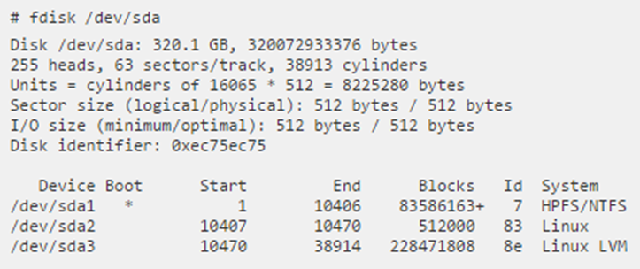
Linux FDISK utility
FDISK is used to display and modify a drive’s partition table.
Drives are accessed as /dev/sda, sdb, etc.
Partitions on the drive are accessed as /dev/sda1, sda2, etc.
Notes:
Linux is capable of accessing many type of file systems.
Notice the different types of file systems (System Column) listed in this example.

Slide 19
Disk Block Caching
Blocks can be cached in kernel memory to eliminate the physical read / write of a drive block.
A block previously read from disk can be maintained in kernel memory in anticipation of a future read or write operation.
Another example of the Locality of Reference.
A process that accesses a disk block is likely to access the same block in the future.
This is especially true of Database Management Systems.

Slide 20
Disk Block Caching
The amount of memory the kernel can dedicate to block caching is limited.
A limited number of blocks can be cached.
A Replacement Policy is needed i.e. deciding which currently cached block to replace when a new block is to be read.
Unlike memory caching, Least Recently Used is practical to implement for the cache management of drive blocks.
The use of a timestamp or stack of cache block references is practical relative the drive’s transfer speeds.

Slide 21
Managing Dirty Disk Blocks
A modified block is not persisted until it is written onto the drive.
Modified cached blocks are susceptible to loss if the system looses power or otherwise crashes.
An issue when the application (e.g. Databases) must guarantee transactions to be persisted.
Operating systems provide system calls that force the ‘flushing’ of buffers and cache to the drive.
In Linux (UNIX), the fsync() system call will block until all dirty data blocks have been written to drive.
Java has FileChannel.force() to flush dirty buffers to drive.

Slide 22
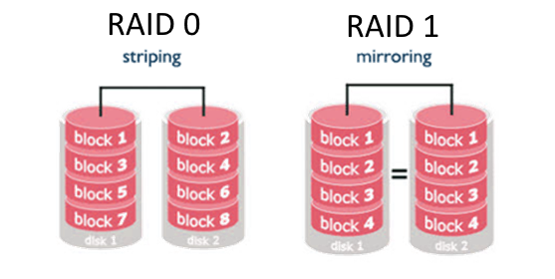
RAID Redundant Array of Independent Disks
Distribute data across multiple independent drives that can operate concurrently.
Potentially allowing multiple requests to be executed concurrently.
Although data is spread across multiple physical disks, the OS presents disk storage as a single (combined) logical drive.
Notes:
RAID volumes are implemented by the disk controller.
Here's a nice link from Fujitsu with a short explanation and some nice animations to help clarify the performance/penalties of RAID. http://www.fujitsu.com/global/products/computing/storage/eternus/glossary/raid/index.html

Slide 23
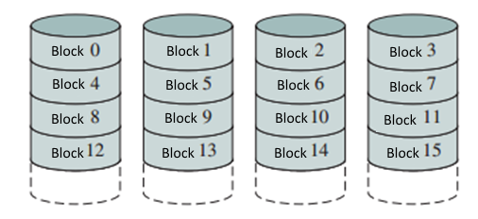
Data Striping
Data striping is a technique of increasing overall I/O performance by dividing sequential data (e.g. a file) so that consecutive blocks are stored on different physical drives.
Striping across N drives allows N blocks to be read in parallel.
Because the block size is fixed, the disk containing a specific offset into a file can be easily calculated.

Slide 24
RAID Offers Two Advantages:
Concurrency: Each of the RAID’s N drives can concurrently execute separate I/O operations.
Redundancy: Data can be replicated across multiple physical disks preventing the loss of the data in the event of a disk’s failure.
We will cover 3 RAID configurations that differ in the amount of concurrency and redundancy.

Slide 25
RAID 0 (Striping)
Data is distributed across multiple disks without redundancy.
A single logical drive spread across N physical drives.
The logical disk is striped across N drives.
With sufficiently sophisticated OS and driver, requests for multiple logical disk blocks can be executed concurrently.

Slide 26
Applying Raid0 Disk Striping
Increased Data Transfer Rates
When a file is contiguously spread across multiple disks, each disk can be accessed concurrently.
Increased Transaction (Operation) Rates
Multiple I/O operations can be executed concurrently if each accesses data blocks on different disks.
When data is spread across N drives there is an increased probability of loosing the data on the entire logical drive because of a single drive failure.
Notes:
Additive Rule implies a greater probability loosing all the data if one of N drives than if the data were stored on a single drive.

Slide 27
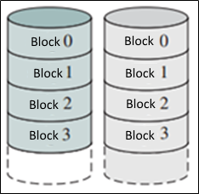
RAID 1 (Disk Mirroring)
Data is duplicated (mirrored) across multiple drives.
Redundant copies of data protects against single-disk failures.
Multiple read operations can be executed concurrently.
Reliable but very expensive to implement i.e. doubles the number of drives and controller.

Slide 28
Logical vs Physical Views
With each RAID level, there is a difference between the logical drive and physical use of the drives.
The OS is presents the RAID as a single logical drive that is physically composed of N disks.
Logically, the OS is presented a single drive of size …
RAID0: The logical drive is of size NM where M is the size of the physical drives and N is the number of drives in the RAID.
RAID1: The logical drive size is half the size of the combined physical drives.
RAID2-6: The logical drive is KM where K is the number of data drives i.e. the total of all physical drives minus the parity drives.
Notes:
N – the number of drives in the RAID
M – the size of individual physical drives.

Slide 29
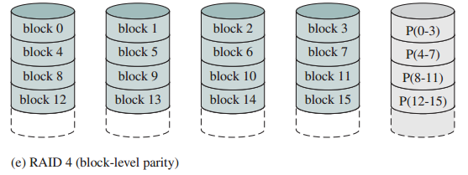
RAID 2-6
These RAID levels offer a combination of data striping (concurrency) and protection against drive failure (redundancy).
Provides redundancy with at least one additional ‘parity’ drive.
A single parity drive maintains parity information sufficient to reconstruct the data lost with any single drive failure.
RAID uses the XOR operation to calculate the contents of the parity block See http://blog.open-e.com/how-does-raid-5-work/

Slide 30
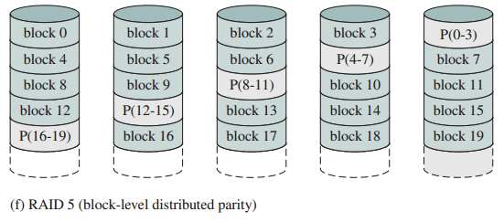
RAID 4 & 5
RAID4 & RAID5 differs in how parity is stored on the drives.
RAID 4 stores the parity information on a the same drive.
RAID 5 stores the parity information across all drives in the raid.
Under normal mode RAID4 & RAID5 allows data striping.
Allowing concurrent reads to data stored in each data drive.
Notes:
In this example, the RAID 4 parity drive will be access once for each write operation to data drives 1-4 meaning the parity drive will be access 4X more often than any single data drive leading to its failure before the other data drives. Raid 5 store parity across all drives in the RAID spreading the load evenly across all drives.

Slide 31
RAID 4 & 5
Write operations requires two block writes:
One write to update the block / strip.
One write to update the parity data on the parity drive.
However, both writes can be executed concurrently.
If a data drive is lost, the RAID operates in reduced mode as each I/O operation requires reconstructing the lost data from the data read / written from the remaining N-1 drives (including the parity drive) in real-time.
RAID has no OS (processor) overhead when implemented by the disk controllers.
Notes:
After the failed drive is replaced with a new empty drive, the RAID controller will rebuild the data blocks on the replaced drive restoring the blocks lost and restoring the RAID to normal operating mode.

